Slide 1
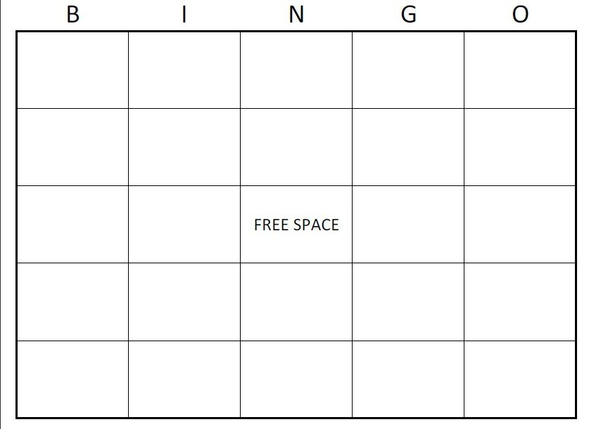
1946
Flash Cards
2011
Nurse Anesthetist
Segregated
Clinton Foundation
Hopalong Cassidy
William Jefferson Blythe
Pappaw
Work Ethic
Blinds
Mammaw
1917
Roger Clinton, JR.
Vince Foster
Grocery Store
High School Graduate
National Park Service
Great Depression
Roger Clinton, SR.
Virginia
Hervey Street
Car Accident
Public Servant

Slide 2
Clinton Foundation
Nurse Anesthetist
Car Accident
Grocery Store
Work Ethic
1946
Pappaw
National Park Service
High School Graduate
William Jefferson Blythe
Roger Clinton , JR.
Mammaw
1917
Public Servant
Blinds
Flash Cards
Hervey Street
Hopalong Cassidy
Vince Foster
Segregated
Roger Clinton, SR.
Great Depression
Virginia
2011

Slide 3
Virginia
Clinton Foundation
Segregated
Flash Cards
Roger Clinton, JR.
Grocery Store
Car Accident
High School Graduate
Roger Clinton, SR.
2011
1946
1917
Work Ethic
Mammaw
National Park Service
William Jefferson Blythe
Pappaw
Vince Foster
Public Servant
Blinds
Hopalong Cassidy
Great Depression
Nurse Anesthetist
Hervey Street

Slide 4
Hopalong Cassidy
Pappaw
Clinton Foundation
1917
Great Depression
2011
Roger Clinton, SR.
Work Ethic
Grocery Store
National Park Service
Roger Clinton, JR.
Hervey Street
William Jefferson Blythe
Public Servant
1946
High School Graduate
Vince Foster
Car Accident
Segregated
Mammaw
Blinds
Nurse Anesthetist
Virginia
Flash Cards

Slide 5
High School Graduate
Mammaw
Roger Clinton, JR.
Hopalong Cassidy
Pappaw
Flash Cards
1917
Clinton Foundation
Hervey Street
William Jefferson Blythe
Great Depression
Segregated
National Park Service
Public Servant
Roger Clinton, SR.
Vince Foster
Virginia
2011
Work Ethic
1946
Car Accident
Blinds
Grocery Store
Nurse Anesthetist

Slide 6
Vince Foster
Segregated
Virginia
1917
Nurse Anesthetist
William Jefferson Blythe
Grocery Store
Roger Clinton, JR.
Flash Cards
Clinton Foundation
2011
Work Ethic
Great Depression
High School Graduate
National Park Service
Car Accident
Blinds
Pappaw
Public Servant
Hervey Street
1946
Roger Clinton, SR.
Hopalong Cassidy
Mammaw

Slide 7
Car Accident
Roger Clinton, SR.
Mammaw
National Park Service
Virginia
Vince Foster
High School Graduate
1917
Work Ethic
Hopalong Cassidy
Grocery Store
Hervey Street
Blinds
2011
Great Depression
1946
William Jefferson Blythe
Public Servant
Pappaw
Clinton Foundation
Flash Cards
Segregated
Nurse Anesthetist
Roger Clinton, JR.

Slide 8
Flash Cards
Hervey Street
Roger Clinton, JR.
Segregated
2011
Mammaw
Work Ethic
Car Accident
High School Graduate
Great Depression
Pappaw
1946
Roger Clinton, SR.
Blinds
Virginia
Nurse Anesthetist
Public Servant
Clinton Foundation
William Jefferson Blythe
Vince Foster
1917
Hopalong Cassidy
Grocery Store
National Park Service

Slide 9
Nurse Anesthetist
Grocery Store
Work Ethic
William Jefferson Blythe
Pappaw
Virginia
1946
Great Depression
Mammaw
Roger Clinton, SR.
Hopalong Cassidy
Clinton Foundation
Car Accident
Hervey Street
Public Servant
National Park Service
2011
Flash Cards
Segregated
Roger Clinton, JR.
High School Graduate
Blinds
1917
Vince Foster

Slide 10
Clinton Foundation
1946
Blinds
Roger Clinton, JR.
Vince Foster
2011
Pappaw
Public Servant
Hervey Street
Great Depression
Grocery Store
1917
Hopalong Cassidy
Segregated
High School Graduate
William Jefferson Blythe
Nurse Anesthetist
Virginia
National Park Service
Flash Cards
Work Ethic
Mammaw
Roger Clinton, SR.
Car Accident

Slide 11
Vince Foster
Blinds
1946
Great Depression
Grocery Store
Mammaw
Hervey Street
National Park Service
Nurse Anesthetist
High School Graduate
Work Ethic
Roger Clinton, SR.
Flash Cards
1917
William Jefferson Blythe
Public Servant
Clinton Foundation
Pappaw
Roger Clinton, JR.
Segregated
Car Accident
Hopalong Cassidy
2011
Virginia

Slide 12
High School Graduate
Car Accident
Grocery Store
William Jefferson Blythe
Clinton Foundation
National Park Service
Virginia
1946
Segregated
Hopalong Cassidy
Great Depression
Flash Cards
Pappaw
Nurse Anesthetist
Blinds
Public Servant
1917
Mammaw
Work Ethic
Vince Foster
2011
Roger Clinton, JR.
Hervey Street
Roger Clinton, SR.

